Slide 1
Codeacademy intro to data analysis capstone: Biodiversity
By Faith Rasmussen

Slide 2
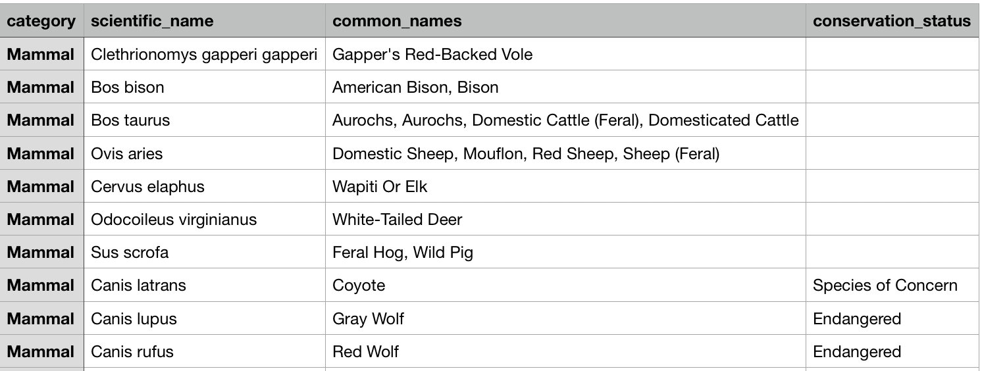
The data contained within species_info.csv includes the category of species, it’s common and scientific names, and it’s conservation status. There are 5,541 unique scientific names. The category of the majority of the species held within the file are vascular plants.

Slide 3
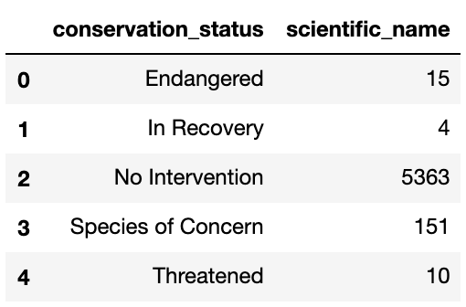
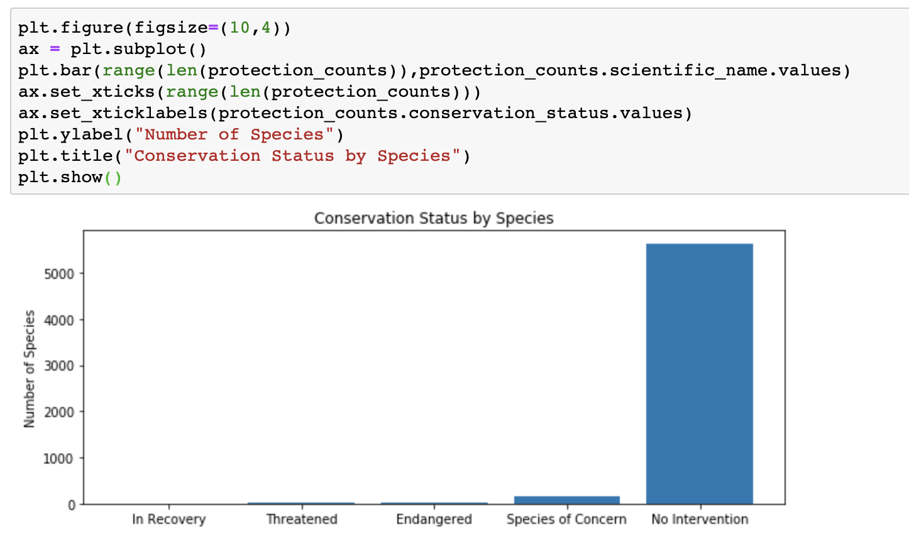
Grouping the species by their conservation status, we see that less than 200 of them are listed under any sort of special conservation status.

Slide 4
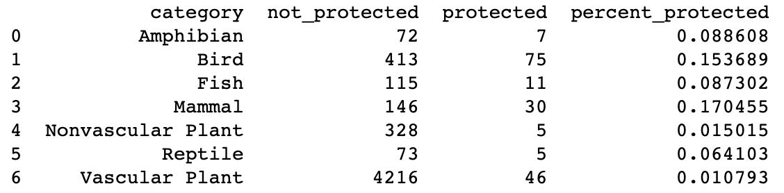
Pivoting the table, re-naming columns, and grouping them by category as well as conservation status, we see that there is a higher percentage of protected species within the mammal and bird categories. But is it significant?

Slide 5
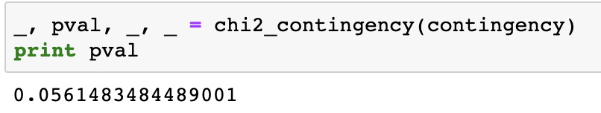
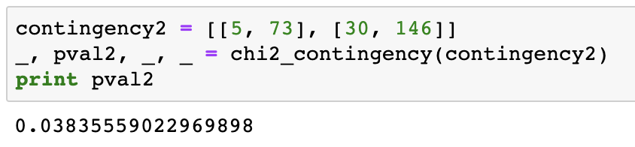
Compared to each other, no. There is no significant difference between the percent of protected mammals to the percent of protected birds, with a p-value above 0.05.
But what about mammals to reptiles?
Yes! With a p-value below 0.05, we do show a significant difference between the percent of protected mammals and the percent of protected reptiles.

Slide 6
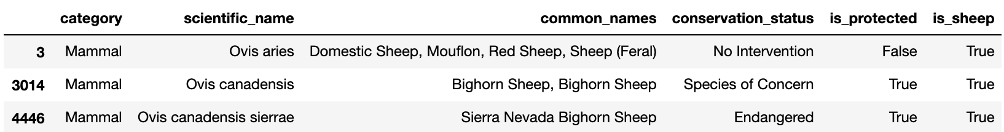
National park sheep observation data
By reading each line of the species_info.csv for the word “sheep” and creating a column that either reads “True” or “False” for the presence of that word in the row, then only displaying rows for which that column reads “True”, and further specifying to only display the rows where is_sheep is “True” and category = mammal, we can display only the observations done on actual sheep in these national parks.

Slide 7
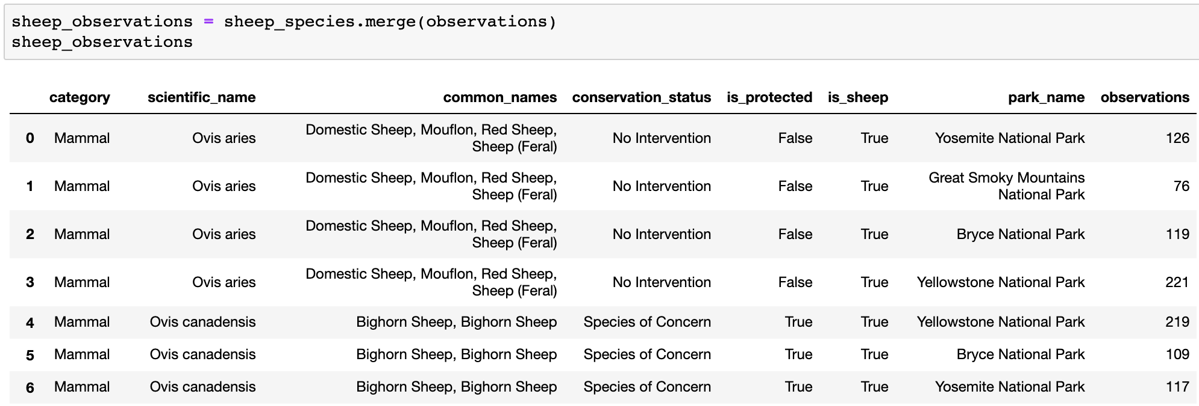
Using the .merge command, we can merge the data frames of sheep_species.csv and observations.csv to fill in observational data about these sheep in national parks.

Slide 8
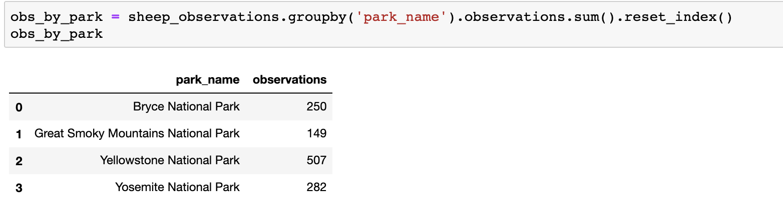
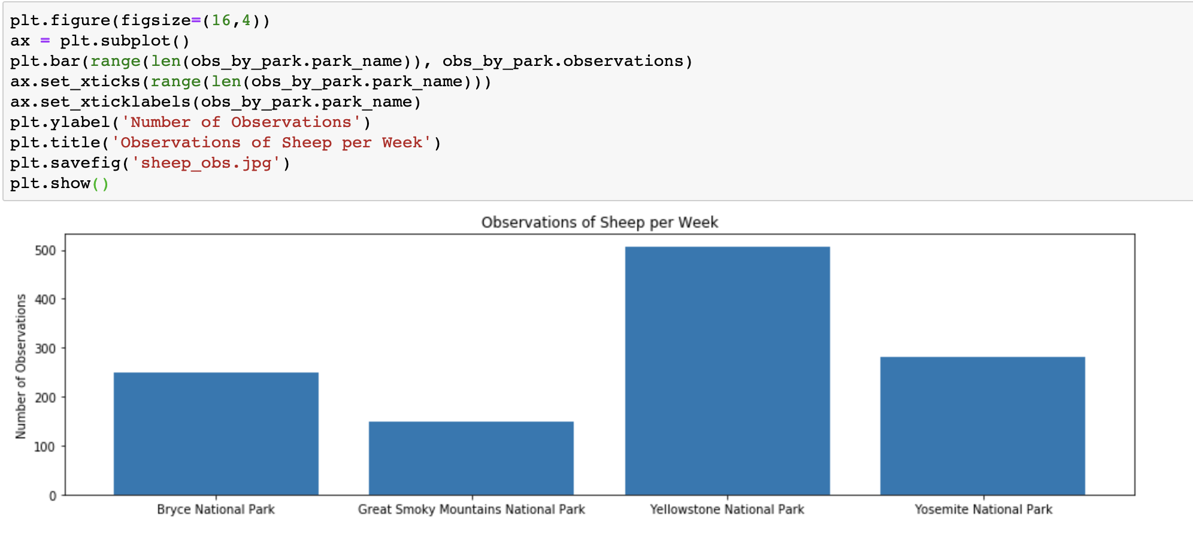
It’s then possible to group the observations by the park that they occurred in, giving us the data needed to make a graph of how many observations of sheep occurred in each park.

Slide 9
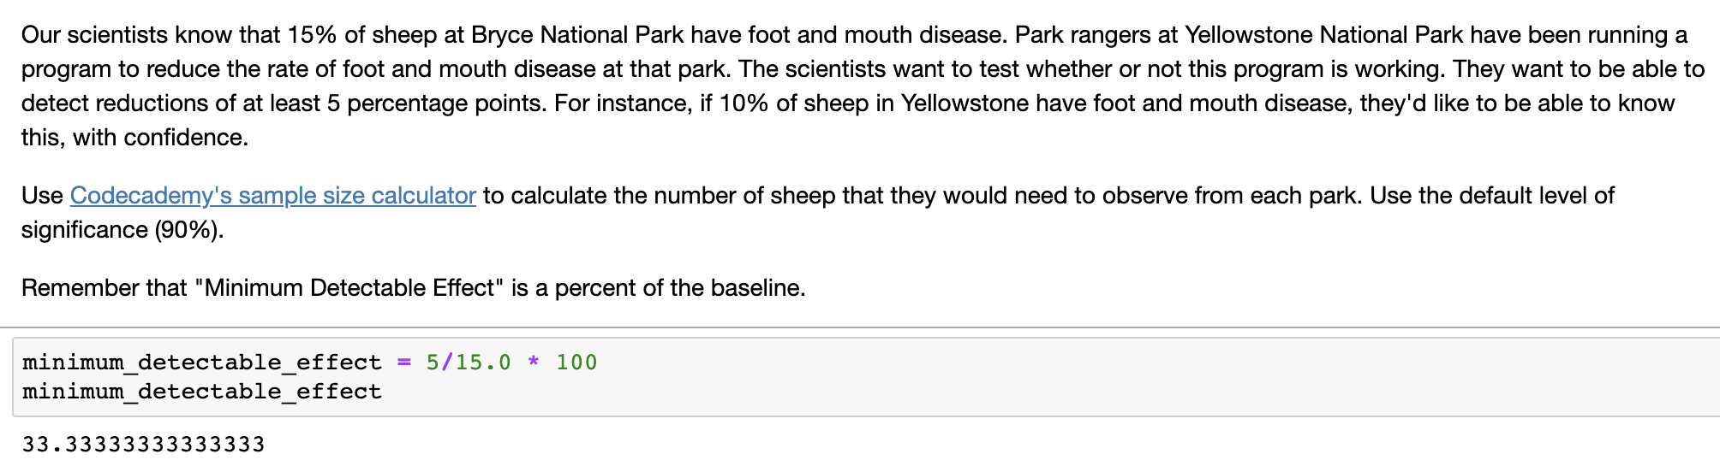
To determine the sample size necessary for statistically significant results, minimum detectable effect was calculated based on a 15% prevalence of foot and mouth disease and detectable limit of 5 percentage points. This gave a necessary sample size of 870 sheep.

Slide 10
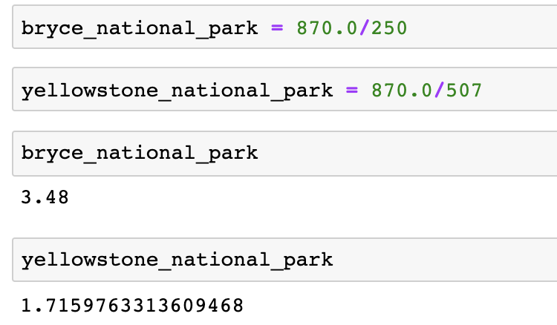
Based on the graph of sheep observations per week in each national park and the sample size necessary for decent data, it would take about 3 ½ weeks (let’s say 4) to gather enough data from Bryce National Park, and about 2 weeks to gather enough data from Yellowstone National Park.

